Slide 1

Lesson 3- CSS Properties

Slide 2
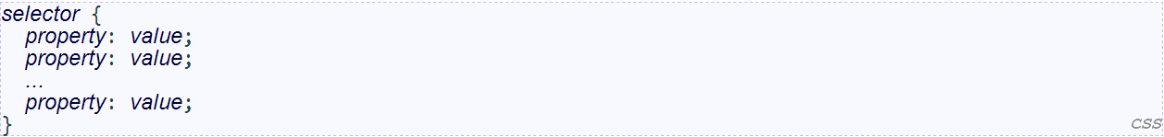
Recall: Basic CSS rule syntax

Slide 3
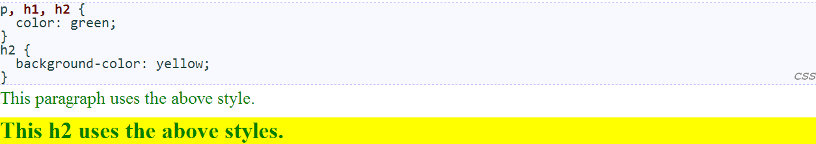
Grouping styles
a style can select multiple elements separated by commas
the individual elements can also have their own styles (like h2 above)

Slide 4
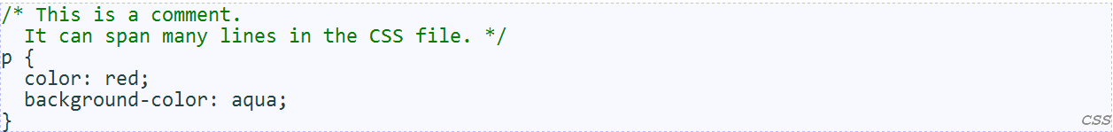
CSS comments: /* ... */
CSS (like HTML) is usually not commented as much as code such as Java
the // single-line comment style is NOT supported in CSS
the <!-- ... --> HTML comment style is also NOT supported in CSS

Slide 5
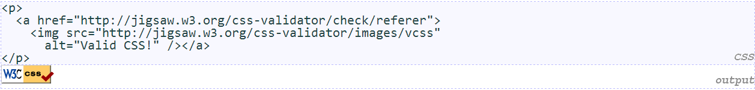
W3C CSS Validator
jigsaw.w3.org/css-validator/
checks your CSS to make sure it meets the official CSS specifications
more picky than the web browser, which may render malformed CSS correctly

Slide 6
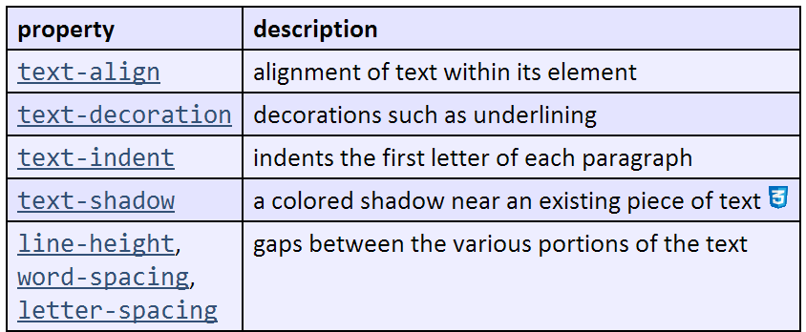
CSS properties for text

Slide 7
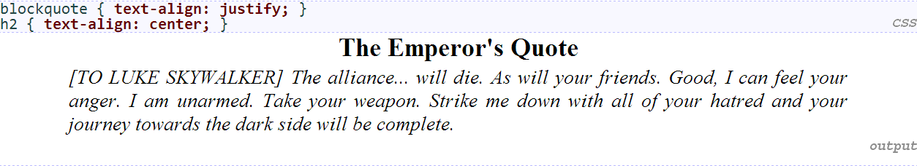
text-align
can be left, right, center, or justify (which widens all full lines of the element so that they occupy its entire width)

Slide 8
text-decoration
can also be overline, line-through, blink, or none
effects can be combined:
text-decoration: overline underline;

Slide 9
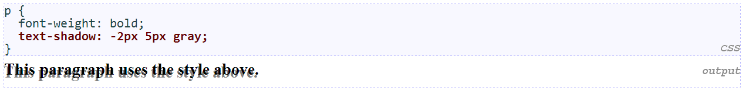
text-shadow
shadow is specified as an X-offset, a Y-offset, and an optional color

Slide 10
The list-style-type property
Possible values:
none : No marker
disc (default), circle, square
decimal : 1, 2, 3, etc.
decimal-leading-zero : 01, 02, 03, etc.
lower-roman : i, ii, iii, iv, v, etc.
upper-roman : I, II, III, IV, V, etc.
lower-alpha : a, b, c, d, e, etc.
upper-alpha : A, B, C, D, E, etc.
lower-greek : alpha, beta, gamma, etc.
others: hebrew, armenian, georgian, cjk-ideographic, hiragana, katakana, hiragana-iroha, katakana-iroha

Slide 11
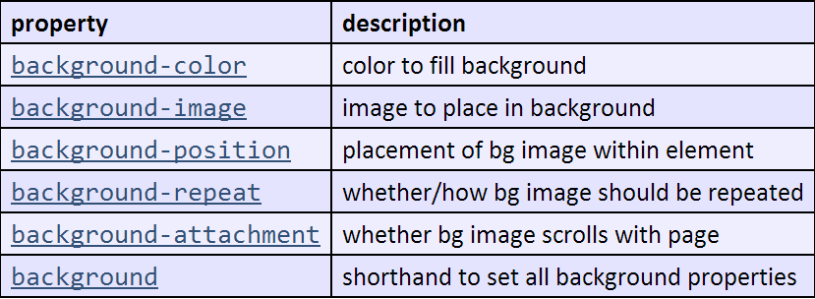
CSS properties for backgrounds

Slide 12
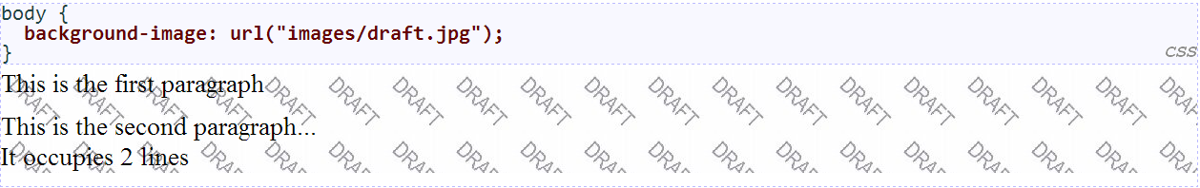
background-image
background image/color fills the element's content area

Slide 13
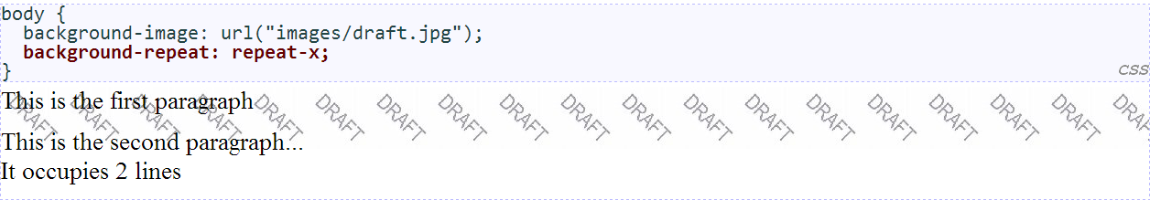
background-repeat
can be repeat (default), repeat-x, repeat-y, or no-repeat

Slide 14
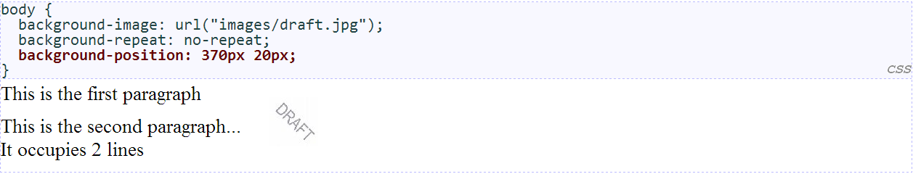
background-position
value consists of two tokens, each of which can be top, left, right, bottom, center, a percentage, or a length value in px, pt, etc.
value can be negative to shift left/up by a given amount

Slide 15
Body styles
to apply a style to the entire body of your page, write a selector for the body element
saves you from manually applying a style to each element

Slide 16
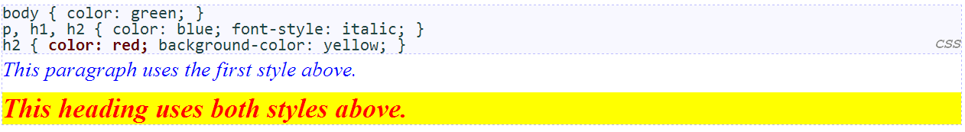
Styles that conflict
when two styles set conflicting values for the same property, the latter style takes precedence
(later we will learn about more specific styles that can override more general styles)

Slide 17
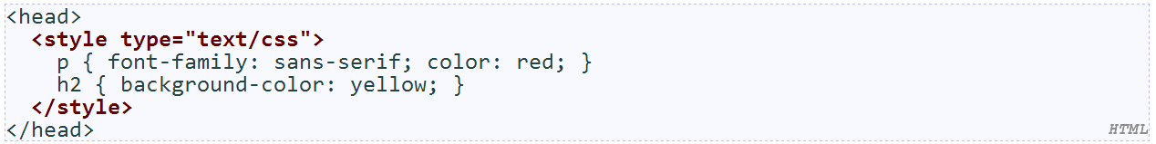
Embedding style sheets: <style> (BAD!)
CSS code can be embedded within the head of an HTML page
this is bad style; DO NOT DO THIS (why?)

Slide 18
Inline styles: the style attribute (BAD!)
higher precedence than embedded or linked styles
used for one-time overrides and styling a particular element
this is bad style; DO NOT DO THIS (why?)

Slide 19
Content vs. presentation
HTML is for content; what is on the page (heading; list; code; etc.)
CSS is for presentation; how to display the page (bold; centered; 20px margin; etc.)
keeping content separate from presentation is a very important web design principle
If the HTML contains no styles, its entire appearance can be changed by swapping .css files

Slide 20
Cascading style sheets
it's called Cascading Style Sheets because the properties of an element cascade together in this order:
browser's default styles (reference)
external style sheet files (in a <link> tag)
internal style sheets (in a <style> tag in the page header)
inline style (the style attribute of an HTML element)

Slide 21
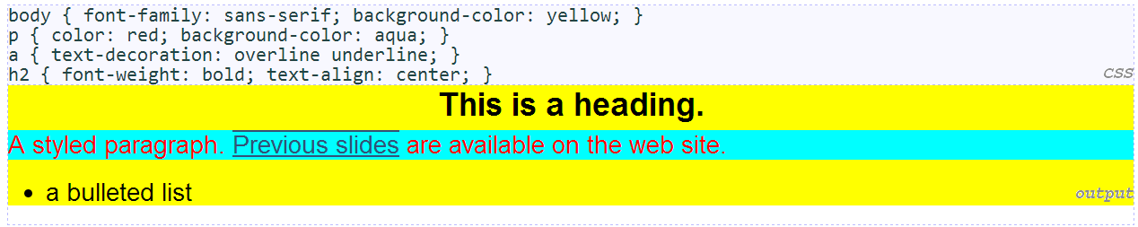
Inheriting styles
when multiple styles apply to an element, they are inherited
a more tightly matching rule can override a more general inherited rule
not all properties are inherited (notice link's color above)

Slide 22
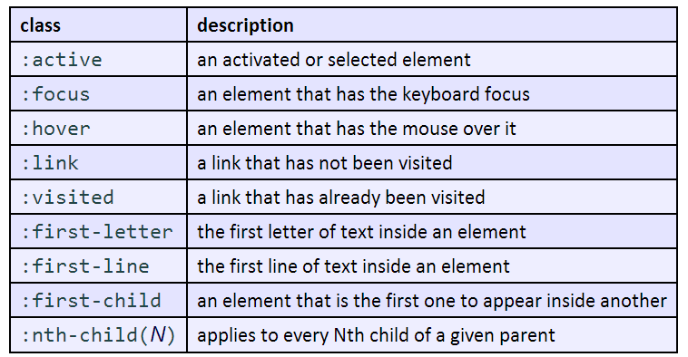
CSS pseudo-classes

Slide 23
Exercise 1
Busy Schedule: Given the following HTML code, write CSS to make the following style changes:
All elements in the body should have a white background with a text color of #330033 and the font Verdana or any serif available on the viewer's computer
The first-level headers are 40px bold serif font. The second-level headers are 24px underlined sans serif.
Paragraph text and lists should have a width of 550px and a top and bottom padding of 10px.
Ordered lists should have a background color of #FFCC99 and unordered lists should have a background color of #CCFFCC. All list elements should be in italics.
Ordered lists should have a background color of #FFCC99 and unordered lists should have a background color of #CCFFCC. All list elements should be in italics.

Slide 24
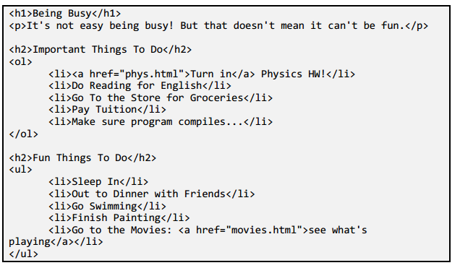

Slide 25
Q & A

